Slide 1


Welcome, to The
Mark Adkins
Institute for Social Research York University

Slide 2
Tidyverse
It is often said that 80% of data analysis is spent on the process of cleaning and preparing the data
-Dasu and Johnson, 2003

Slide 3
Tidyverse
It is often said that 80% of data analysis is spent on the process of cleaning and preparing the data
-Dasu and Johnson, 2003
The tidyverse is an opinionated collection of R packages designed for data science. All packages share an underlying design philosophy, grammar, and data structures.
-www.tidyverse.org

Slide 4


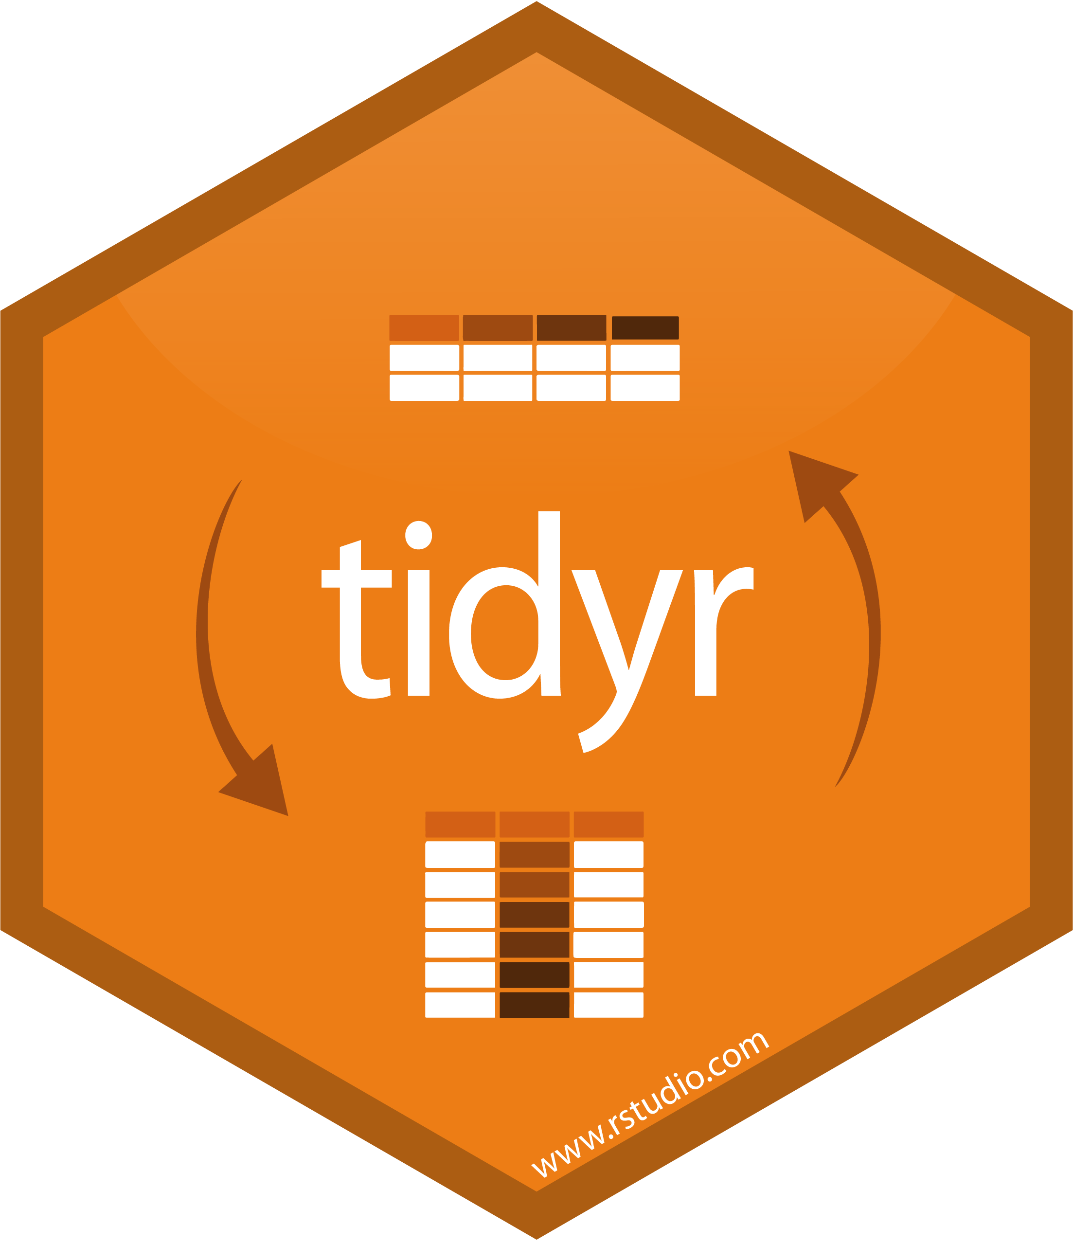





Tidyverse – Core Packages

Slide 5



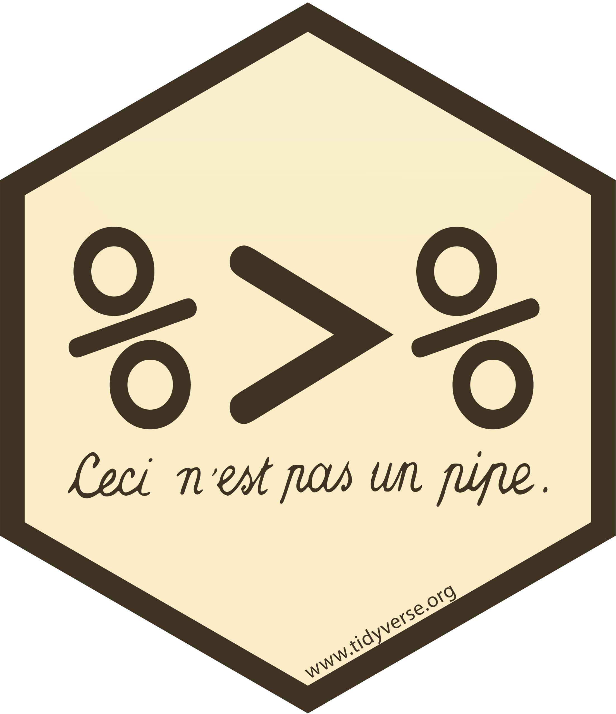

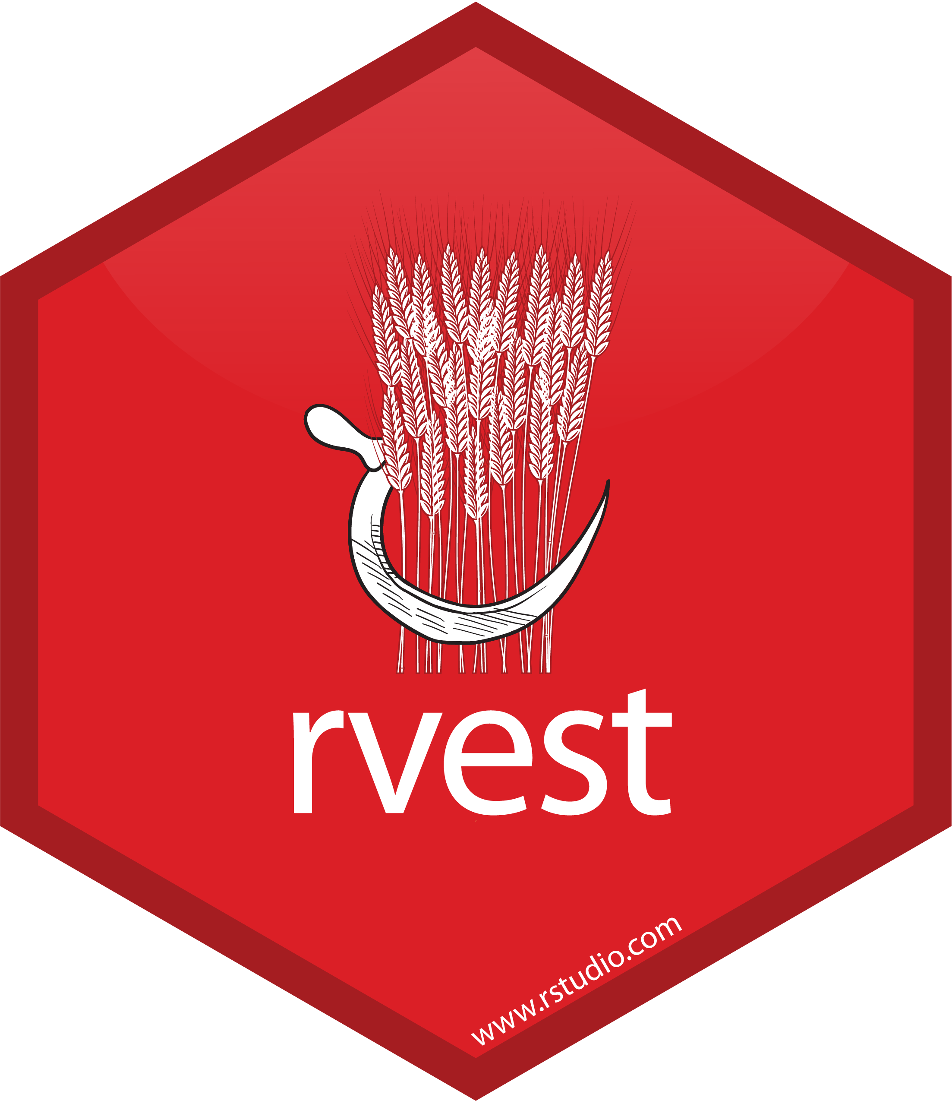
Tidyverse – 26 Packages

Slide 6

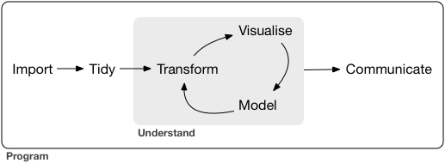
Data analysis Workflow

Slide 7
Data analysis Workflow - Wrangling

Slide 8
Data analysis Workflow - Wrangling

Slide 9
Data analysis Workflow - Wrangling

Slide 10
Data analysis Workflow - Wrangling

Slide 11
Getting started
First, I HIGHLY recommend telling Rstudio to never save your workspace!
Go to Tools > Global Options..
On the General tab find the drop-down menu entitled “Save workspace to .Rdata on exit:” and change it to Never

Slide 12

Getting started – help documentation
We have talked a bit about functions already, but a very important part of function is understanding how to read help documentation
We can search the name of the function on the help tab (we can also type ? Followed by the name of the function in the console pane of Rstudio)
Google the name of the function with another search term “rdocumentation” e.g., “filter rdocumentation”

Slide 13
Getting started – cheatsheets
There will be a couple of times I reference cheatsheets.
You can download them by clicking on the “Help” menu and finding the Cheatsheet you want to download within the list.
You can also peruse the complete set of Cheatsheets on RStudio’s webpage at:
https://www.rstudio.com/resources/cheatsheets/

Slide 14
Getting started – finding packages
Sometime you might need to conduct a specific analysis or task within R, but you don’t know the name of a package that contains the functions you might need
I go to the website https://www.r-pkg.org/ to find popular R packages that might help me

Slide 15
Getting started - tidyverse
The symbol “>” will be used to represent the command prompt in R. Anything that follows will be examples of actual R code.
># install all of the packages in the tidyverse
> install.packages(“tidyverse”)
># load the set of core packages
> library(tidyverse)

Slide 16
Useful tidyverse functions
>tidyverse_conflicts() >tidyverse_update() >tidyverse_packages()

Slide 17
Tibbles vs. data.frames
Tibbles (tidy tables) differ from data.frames in three distinct ways
Printing - defaults to only 10 rows and as many column that fit in the console.
Sub-setting - sub-setting a tibble always returns another tibble, while sub-setting a data.frame can return vectors of data.frames
Recycling – Only vectors of length 1 are recycled. Errors are thrown when this rule is violated.
There are no row names!!!

Slide 18
Import data
readr currently supports many common file formats:
Comma separated files (CSV)
read_csv()
Tab separated files
read_tsv()
General delimited files
read_delim()

Slide 19
Import data – BASE vs. readr
Naming conventions:
Base R function names typically uses “.” > read.csv(readr_example("mtcars.csv"))
readr function names use “_” > read_csv(readr_example("mtcars.csv"))
readr functions are up to 10x faster
readr functions display a progress bar during long load times
readr does NOT automatically convert strings to factors

Slide 20
Import data – BASE vs. readr
Class of object returned:
Base R creates data.frame > class(read.csv(readr_example("mtcars.csv"))) “data.frame”
readr creates tibbles > class(read_csv(readr_example("mtcars.csv"))) “tbl_df” “tbl” “data.frame”

Slide 21
Import data – BASE vs. readr
Feedback on the import process:
Base R
NOTHING!!!
readr
#> Parsed with column specification: #> cols( #> mpg = col_double(), #> cyl = col_integer(), … #> )

Slide 22
Import data – BASE vs. readr
Missing data:
Base R
Silently converts unknown values to NA
readr
Issues a warning when converting values to NA
Extract the problems using the “problems” function on your data after you import it > problems(data)
See exactly how R interpreted each column type > spec(data)

Slide 23
Import data – Other file formats
The tidyverse also can import file formats from other statistical software:
First, load the non-core library package “Haven” > library(haven)
Then, import your data using the following functions
SAS – read_sas()
STATA – read_dta()
SPSS – read_sav()

